Slide 1
ArrayList
Aug 9, 2007

Slide 2
What’s an Array List
ArrayList is
  a class in the standard Java libraries that can hold any type of object
  an object that can grow and shrink while your program is running (unlike arrays, which have a fixed length once they have been created)
In general, an ArrayList serves the same purpose as an array, except that an ArrayList can change length while the program is running
Aug 9, 2007

Slide 3
The ArrayList Class
The class ArrayList is implemented using an array as a private instance variable
  When this hidden array is full, a new larger hidden array is created and the data is transferred to this new array
Aug 9, 2007
Copyright © 2008 Pearson Addison-Wesley.
All rights reserved

Slide 4
Using the ArrayList Class
In order to make use of the ArrayList class, it must first be imported
import java.util.ArrayList;
An ArrayList is created and named in the same way as object of any class, except that you specify the base type as follows:
  ArrayList<BaseType> aList =
  new ArrayList<BaseType>();
Aug 9, 2007
Copyright © 2008 Pearson Addison-Wesley.
All rights reserved

Slide 5
Creating an ArrayList
An initial capacity can be specified when creating an ArrayList as well
  The following code creates an ArrayList that stores objects of the base type String with an initial capacity of 20 items
ArrayList<String> list = new ArrayList<String>(20);
  Specifying an initial capacity does not limit the size to which an ArrayList can eventually grow
Note that the base type of an ArrayList is specified as a type parameter
Aug 9, 2007
Copyright © 2008 Pearson Addison-Wesley.
All rights reserved

Slide 6
Adding elements to an ArrayList
The add method is used to add an element at the “end” of an ArrayList
    list.add("something");
  The method name add is overloaded
  There is also a two argument version that allows an item to be added at any currently used index position or at the first unused position
Aug 9, 2007
Copyright © 2008 Pearson Addison-Wesley.
All rights reserved

Slide 7
How many elements?
The size method is used to find out how many indices already have elements in the ArrayList
    int howMany = list.size();
The set method is used to replace any existing element, and the get method is used to access the value of any existing element
    list.set(index, "something else");
    String thing = list.get(index);
size is NOT capacity
  size is the number of elements currently stored in the ArrayList
  Capacity is the maximum number of elements which can be stored. Capacity will automatically increase as needed
Aug 9, 2007
Copyright © 2008 Pearson Addison-Wesley.
All rights reserved

Slide 8
ArrayList code Example
// Note the use of Integer, rather than int
public static void main( String[ ] args)
{
ArrayList<Integer> myInts = new ArrayList<Integer>(25);
System.out.println( “Size of myInts = “ + myInts.size());
for (int k = 0; k < 10; k++)
myInts.add( 3 * k );
myInts.set( 6, 44 );
System.out.println( “Size of myInts = “ + myInts.size());
for (int k = 0; k < myInts.size(); k++)
System.out.print( myInts.get( k ) + “, “ );
}
// output
Size of myInts = 0
Size of myInts = 10
0, 3, 6, 9, 12, 15, 44, 21, 24, 27
Aug 9, 2007

Slide 9
Methods in the Class ArrayList
The tools for manipulating arrays consist only of the square brackets and the instance variable length
ArrayLists, however, come with a selection of powerful methods that can do many of the things for which code would have to be written in order to do them using arrays
Aug 9, 2007
Copyright © 2008 Pearson Addison-Wesley.
All rights reserved

Slide 10
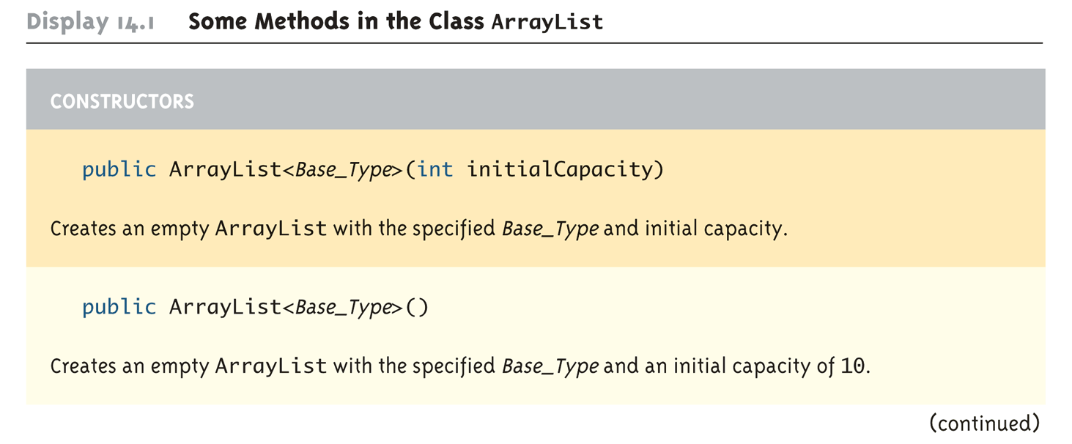
Some Methods in the Class ArrayList (Part 1 of 11)
Aug 9, 2007
Copyright © 2008 Pearson Addison-Wesley.
All rights reserved

Slide 11
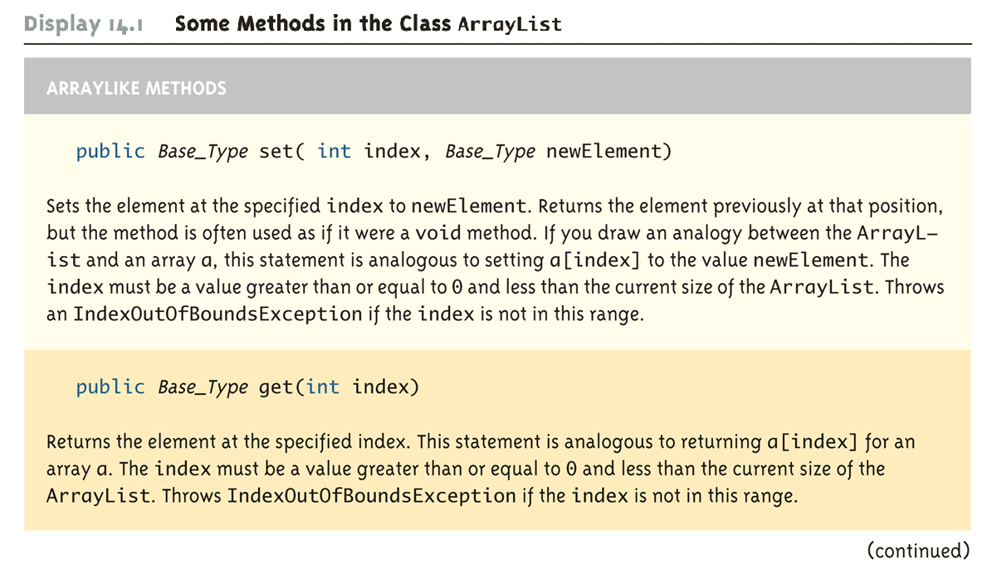
Some Methods in the Class ArrayList (Part 2 of 11)
Aug 9, 2007
Copyright © 2008 Pearson Addison-Wesley.
All rights reserved

Slide 12
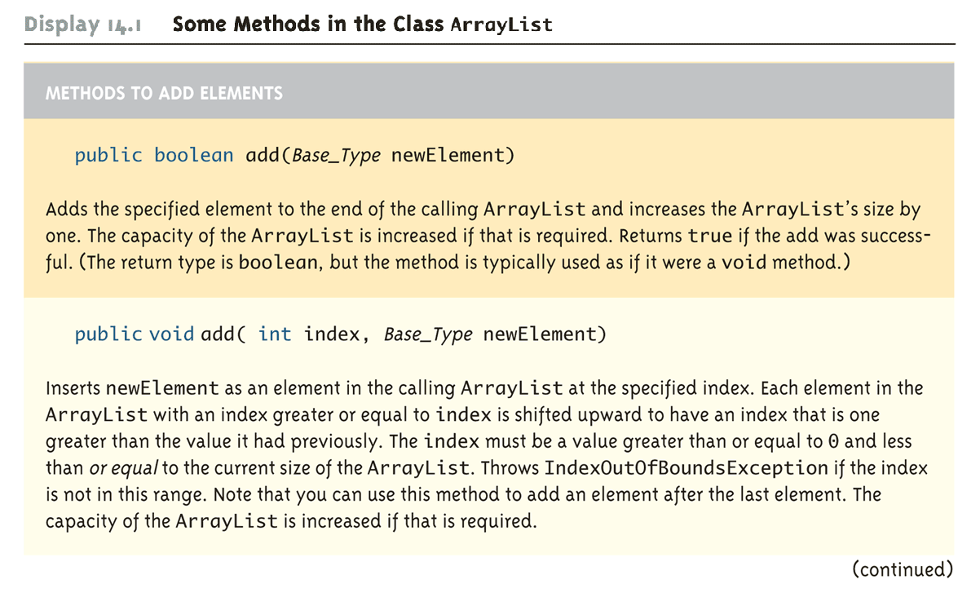
Some Methods in the Class ArrayList (Part 3 of 11)
Aug 9, 2007
Copyright © 2008 Pearson Addison-Wesley.
All rights reserved

Slide 13
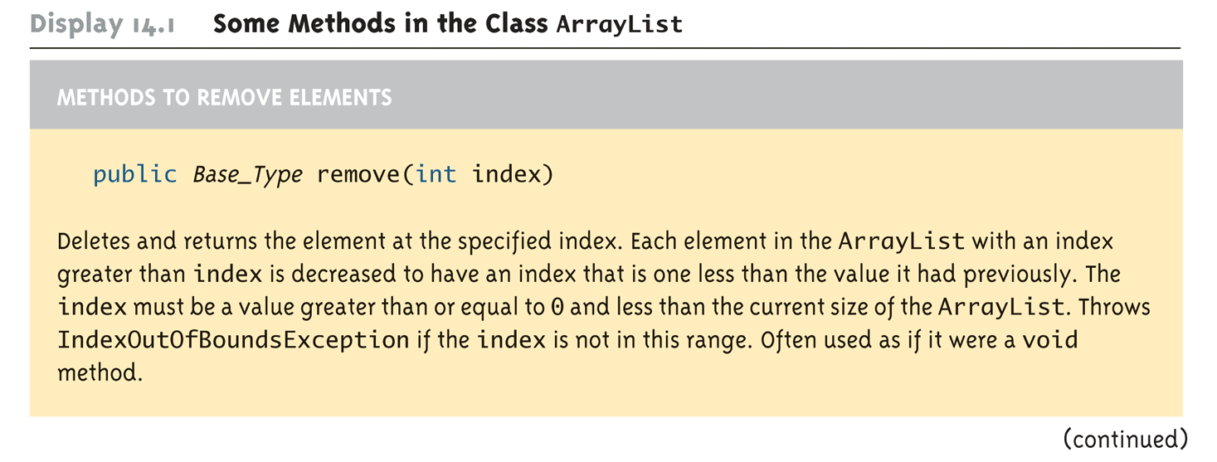
Some Methods in the Class ArrayList (Part 4 of 11)
Aug 9, 2007
Copyright © 2008 Pearson Addison-Wesley.
All rights reserved

Slide 14
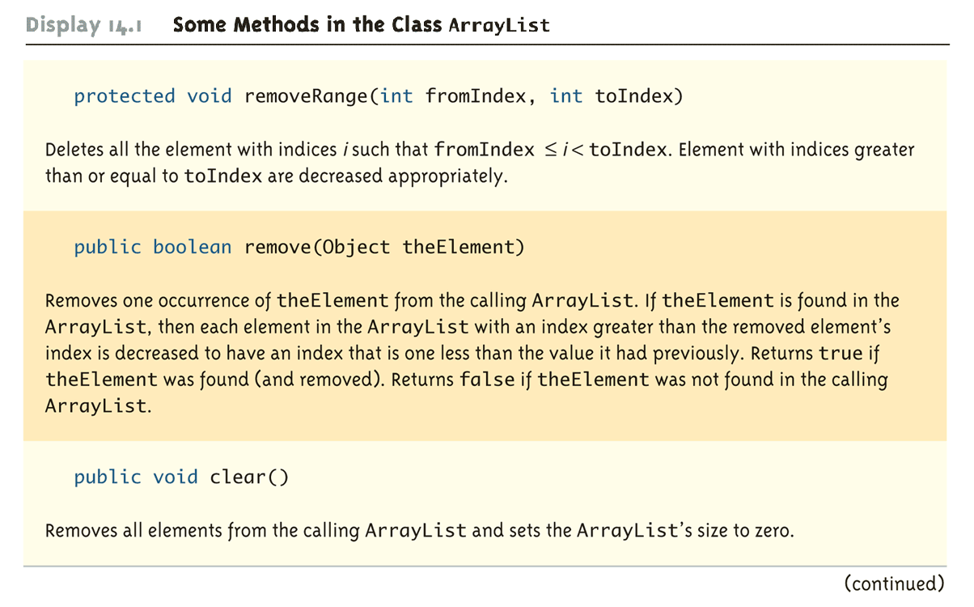
Some Methods in the Class ArrayList (Part 5 of 11)
Aug 9, 2007
Copyright © 2008 Pearson Addison-Wesley.
All rights reserved

Slide 15
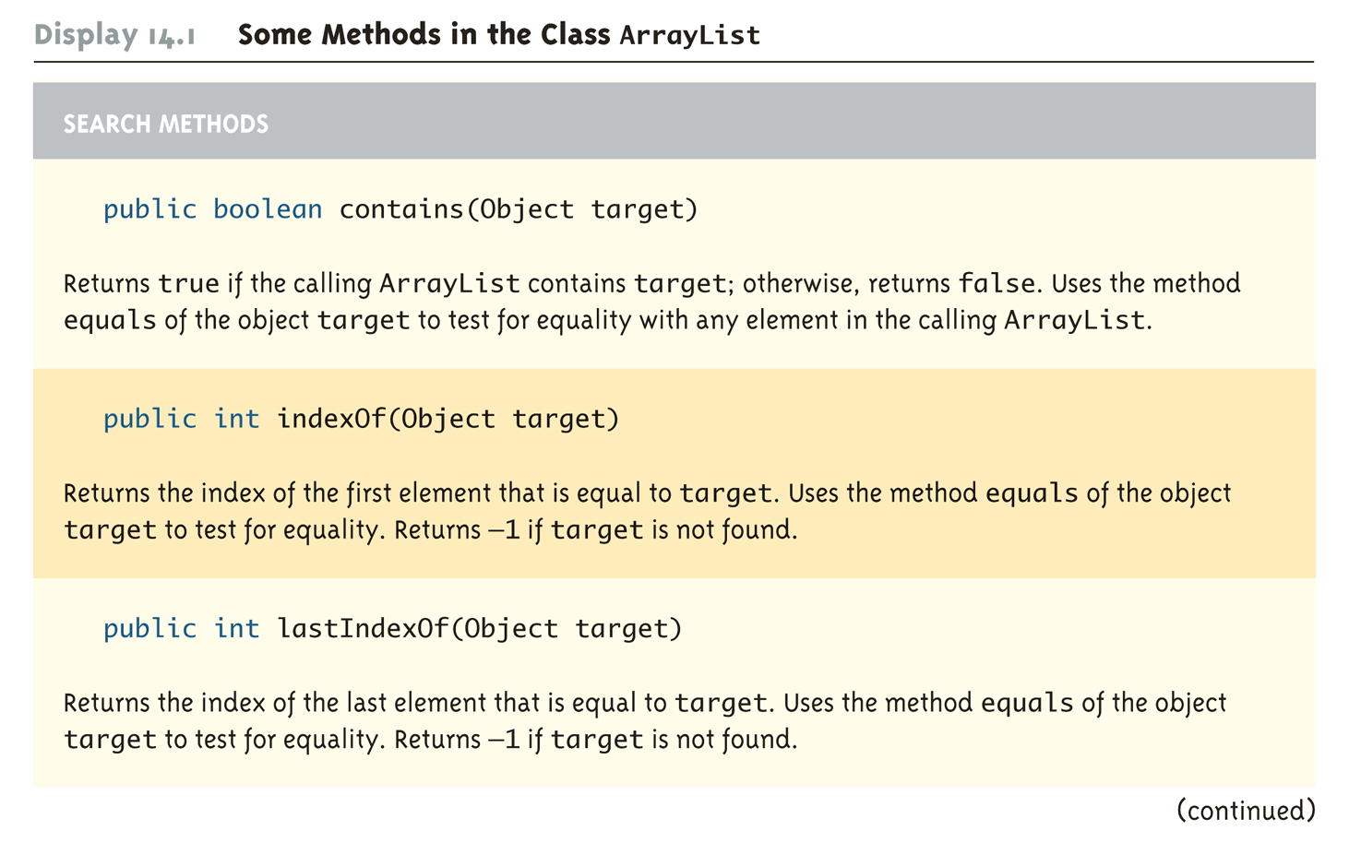
Some Methods in the Class ArrayList (Part 6 of 11)
Aug 9, 2007
Copyright © 2008 Pearson Addison-Wesley.
All rights reserved

Slide 16
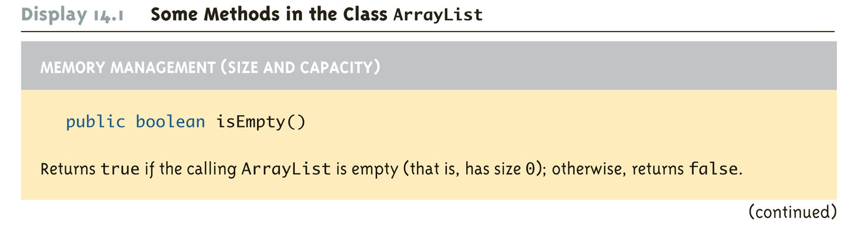
Some Methods in the Class ArrayList (Part 7 of 11)
Aug 9, 2007
Copyright © 2008 Pearson Addison-Wesley.
All rights reserved

Slide 17
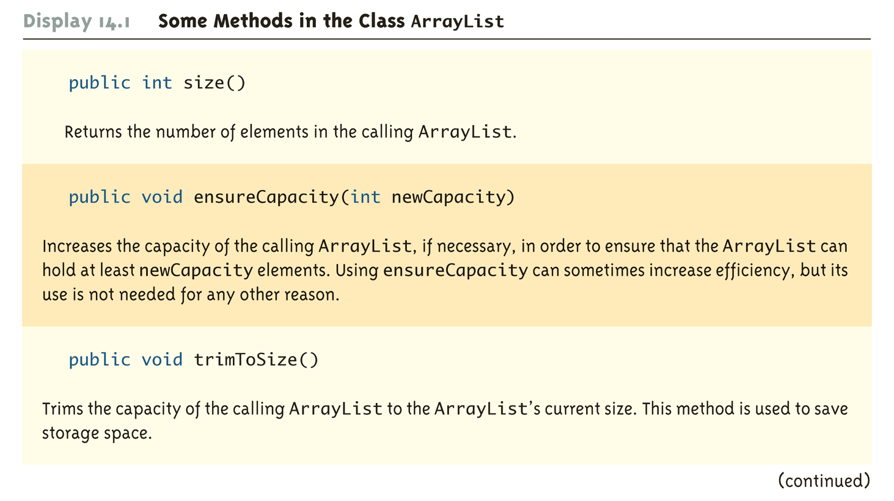
Some Methods in the Class ArrayList (Part 8 of 11)
Aug 9, 2007
Copyright © 2008 Pearson Addison-Wesley.
All rights reserved

Slide 18
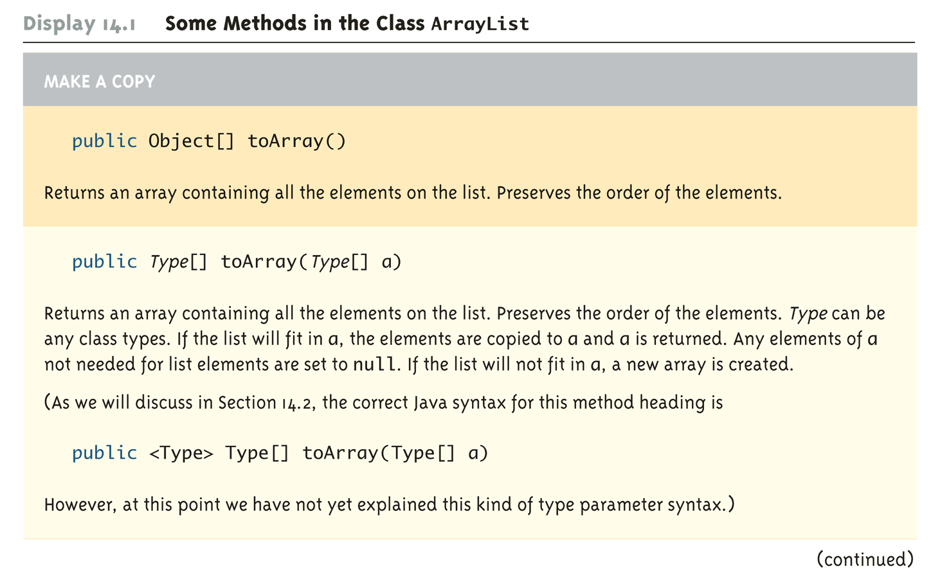
Some Methods in the Class ArrayList (Part 9 of 11)
Aug 9, 2007
Copyright © 2008 Pearson Addison-Wesley.
All rights reserved

Slide 19
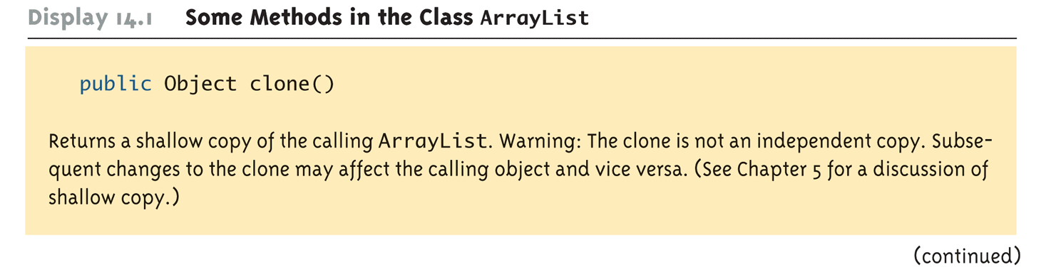
Some Methods in the Class ArrayList (Part 10 of 11)
Aug 9, 2007
Copyright © 2008 Pearson Addison-Wesley.
All rights reserved

Slide 20
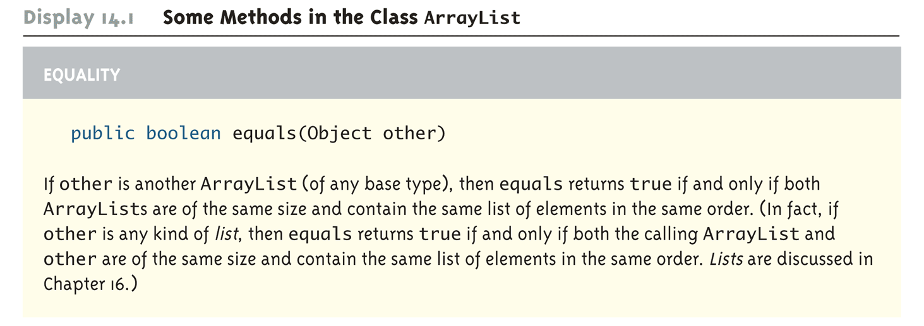
Some Methods in the Class ArrayList (Part 11 of 11)
Aug 9, 2007
Copyright © 2008 Pearson Addison-Wesley.
All rights reserved

Slide 21
More example code
// Note the use of Integer instead of int
public static void main( String[ ] args)
{
ArrayList<Integer> myInts = new ArrayList<Integer>(25);
System.out.println( “Size of myInts = “ + myInts.size());
for (int k = 0; k < 10; k++)
myInts.add( 3 * k );
myInts.set( 6, 44 );
myInts.add( 4, 42 );
myInts.remove( new Integer(99) );
System.out.println( “Size of myInts = “ + myInts.size());
for (int k = 0; k < myInts.size(); k++)
System.out.print( myInts.get( k ) + “, “ );
if (myInts.contains( 57 ) ) System.out.println(“57 found”);
System.out.println (“44 found at index “ + myInts.indexOf(44));
}
Aug 9, 2007

Slide 22
Why are Some Parameters of Type Base_Type and Others of type Object
When looking at the methods available in the ArrayList class, there appears to be some inconsistency
  In some cases, when a parameter is naturally an object of the base type, the parameter type is the base type
  However, in other cases, it is the type Object
This is because the ArrayList class implements a number of interfaces, and inherits methods from various ancestor classes
  These interfaces and ancestor classes specify that certain parameters have type Object
Aug 9, 2007
Copyright © 2008 Pearson Addison-Wesley.
All rights reserved

Slide 23
The "For Each" Loop
The ArrayList class is an example of a collection class
Starting with version 5.0, Java has added a new kind of for loop called a for-each or enhanced for loop
  This kind of loop has been designed to cycle through all the elements in a collection (like an ArrayList)
Aug 9, 2007
Copyright © 2008 Pearson Addison-Wesley.
All rights reserved

Slide 24
“for-each” example
public class ForEach
{
public static void main(String[ ] args)
{
ArrayList<Integer> list = new ArrayList<Integer>;
list.add( 42 );
list.add( 57 );
list.add( 86 );
// “for each Integer, i, in list”
for( Integer i : list )
System.out.println( i );
}
}
//-- Output ---
42
57
86
Aug 9, 2007

Slide 25
Copying an ArrayList
  // create an ArrayList of Integers
  ArrayList<Integer> a = new ArrayList<Integer>( );
  a.add(42); a.add(57); a.add(86);
Assignment doesn’t work
  As we’ve seen with any object, using assignment just makes two variables refer to the same ArrayList.
ArrayList<Integer> b = a;
a
b
42
57
86
Stack
Heap
Aug 9, 2007

Slide 26
Copying an ArrayList
ArrayList’s clone( ) method makes a shallow copy
ArrayList<Integer> b = a.clone( );
42
57
86
a
b
Stack
Heap
Aug 9, 2007

Slide 27
Copying an ArrayList
We need to manually make a deep copy
ArrayList<Integer> b = a.clone( );
for( int k = 0; k < b.size( ); k++)
b.set(k, a.get(k));
42
57
86
42
57
86
a
b
Stack
Heap
Aug 9, 2007

Slide 28
ArrayList vs Array
Why use an array instead of an ArrayList
  An ArrayList is less efficient than an array
  ArrayList does not have the convenient square bracket notation
  The base type of an ArrayList must be a class type (or other reference type). It cannot be a primitive type. (Although wrappers, auto boxing, and auto unboxing make this a non-issue with Java 5)
Aug 9, 2007
Copyright © 2008 Pearson Addison-Wesley.
All rights reserved

Slide 29
ArrayList vs Array
Why use an ArrayList instead of an array?
  Arrays can’t grow. Their size is fixed at compile time.
    ArrayList grows and shrinks as needed while your program is running
  You need to keep track of the actual number of elements in your array (recall partially filled arrays).
    ArrayList will do that for you.
  Arrays have no methods (just length instance variable)
    ArrayList has powerful methods for manipulating the objects within it
Aug 9, 2007

Slide 30
The Vector Class
The Java standard libraries have a class named Vector that behaves almost exactly the same as the class ArrayList
In most situations, either class could be used, however the ArrayList class is newer (Java 5), and is becoming the preferred class
Aug 9, 2007
Copyright © 2008 Pearson Addison-Wesley.
All rights reserved

